Slide 1


Hominoid
An anti-phishing plugin proof of concept
Diego Freijo

Slide 2
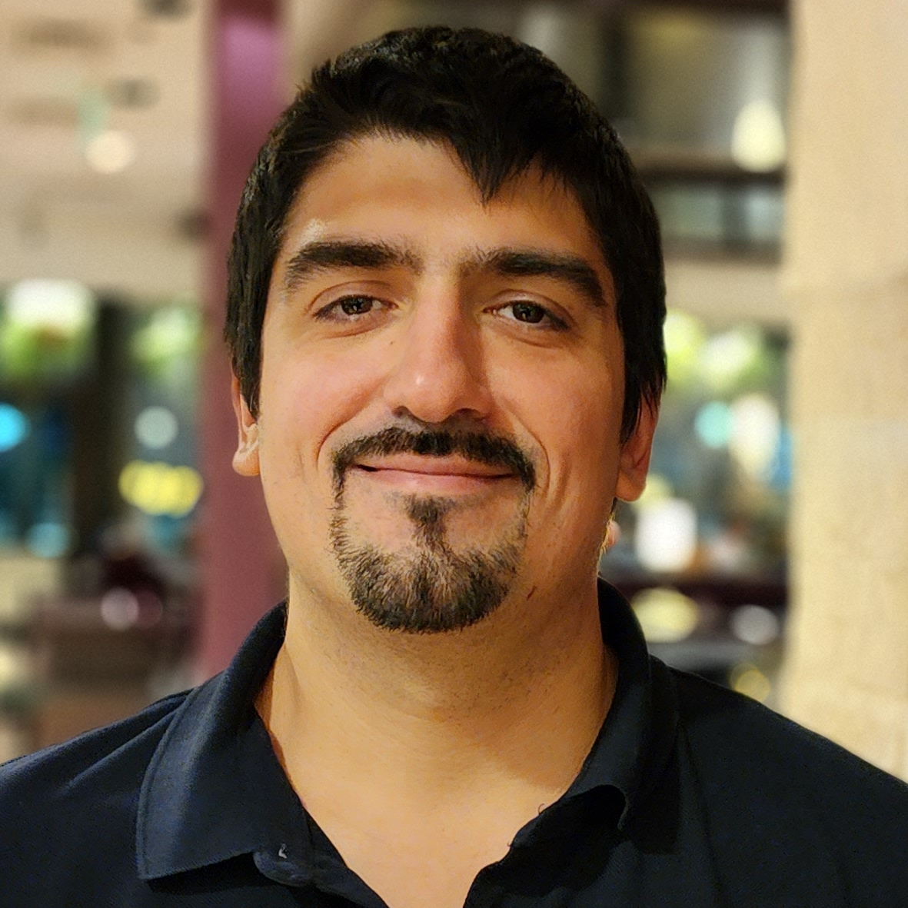
whoami
Senior Security Consultant en Anvil
Desarrollador Web
(ex) Desarrollador de Juegos
Militante de la Menta Granizada
Hominoid: An anti-phishing plugin proof of concept – Diego Freijo

Slide 3
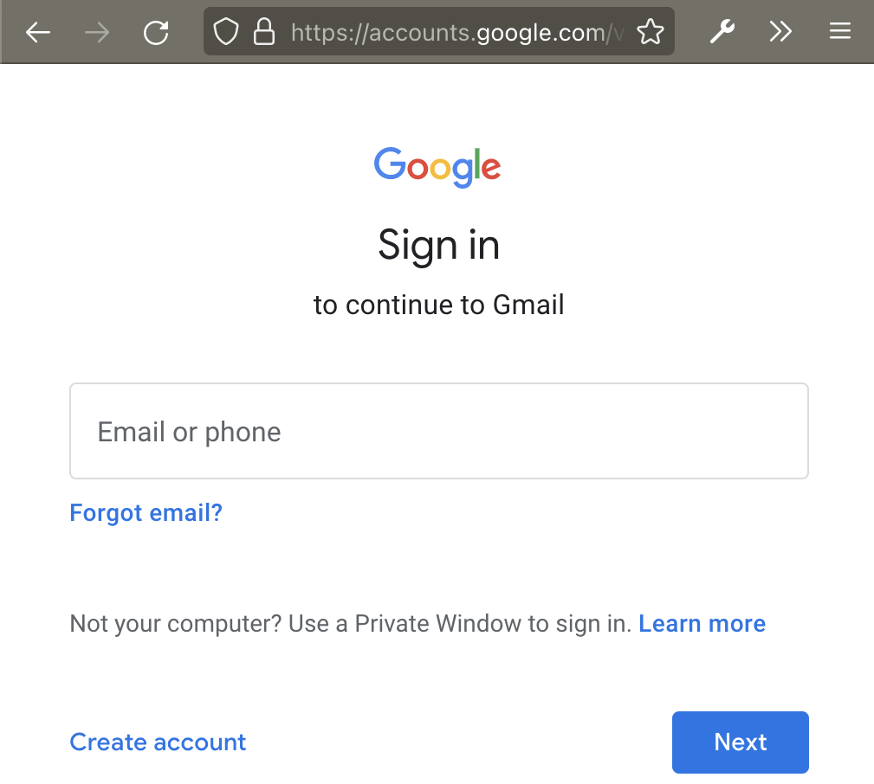
Problema
Hominoid: An anti-phishing plugin proof of concept – Diego Freijo

Slide 4
Problema
👍
Hominoid: An anti-phishing plugin proof of concept – Diego Freijo

Slide 5
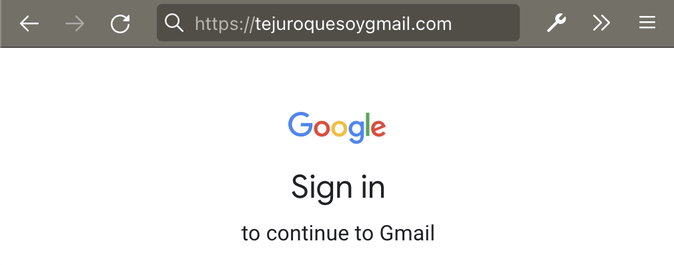
Problema
😱
Hominoid: An anti-phishing plugin proof of concept – Diego Freijo

Slide 6
Como lo automatizamos?
🤔
Hominoid: An anti-phishing plugin proof of concept – Diego Freijo
Notes:
No alcanza, puede ser distinto
Ataque a humanos, lo que ven

Slide 7
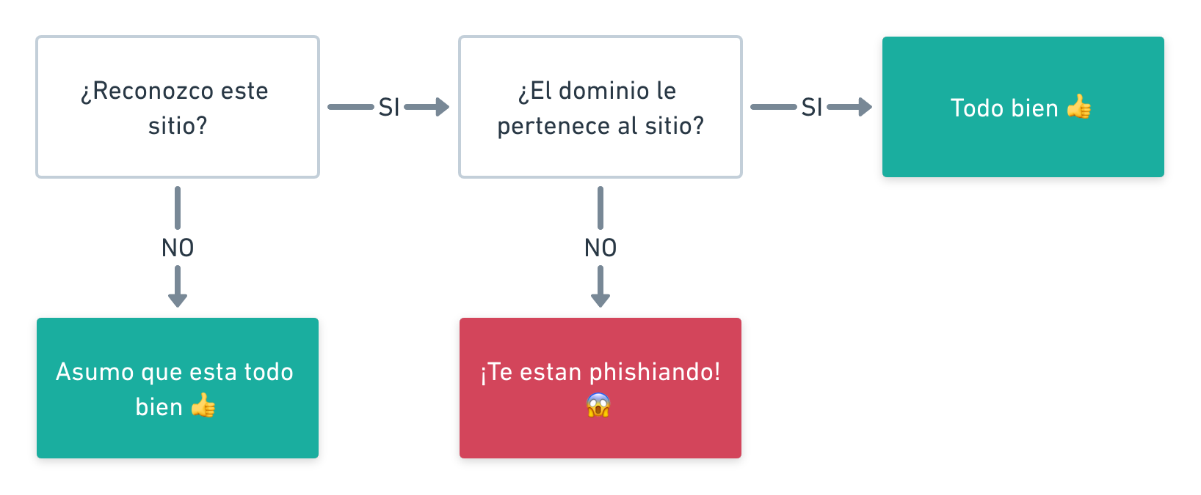
Hominoid: An anti-phishing plugin proof of concept – Diego Freijo

Slide 8
Reconociendo sitios
HTML?
🤔
Hominoid: An anti-phishing plugin proof of concept – Diego Freijo
Notes:
No alcanza, puede ser distinto
Ataque a humanos, lo que ven

Slide 9
Reconociendo sitios
Comparemos imagenes!
💡
Hominoid: An anti-phishing plugin proof of concept – Diego Freijo

Slide 10
Reconociendo sitios
Comparemos imagenes!
💡
Pero y si cambia un pixel?
🤔
Hominoid: An anti-phishing plugin proof of concept – Diego Freijo
Notes:
Por ej si es en otro idioma

Slide 11
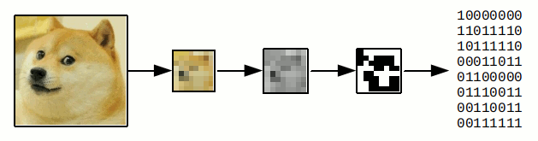
Perceptual Hashing
Creditos: Diego Essaya, Taringa!
Hominoid: An anti-phishing plugin proof of concept – Diego Freijo
Notes:
Get a signature from an image
A hash that resembles the original image
Can compare similar images

Slide 12
Y que hago con la firma?
Servidor central?
👎
Hominoid: An anti-phishing plugin proof of concept – Diego Freijo

Slide 13
Y que hago con la firma?
Servidor central?
👎
Mas privacidad?
🤔
Hominoid: An anti-phishing plugin proof of concept – Diego Freijo

Slide 14

SSH al rescate
Hominoid: An anti-phishing plugin proof of concept – Diego Freijo

Slide 15
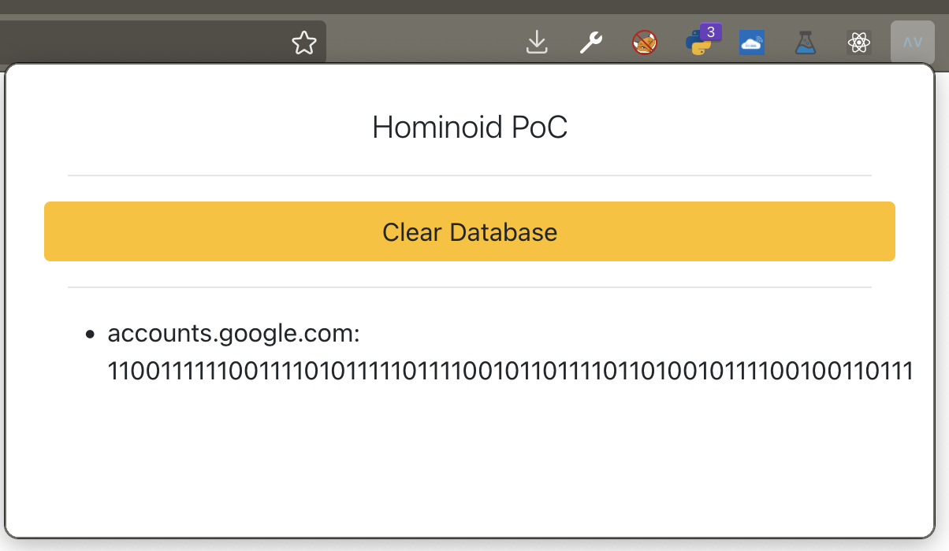



Uniendo todo en una extensión
Hominoid: An anti-phishing plugin proof of concept – Diego Freijo

Slide 16
Demo!
Hominoid: An anti-phishing plugin proof of concept – Diego Freijo

Slide 17
En cada pagina
1. Achico ventana
2. Capturo pantalla
3. Calculo firma
4. Verifico firma
5. Notifico al usuario
Hominoid: An anti-phishing plugin proof of concept – Diego Freijo

Slide 18
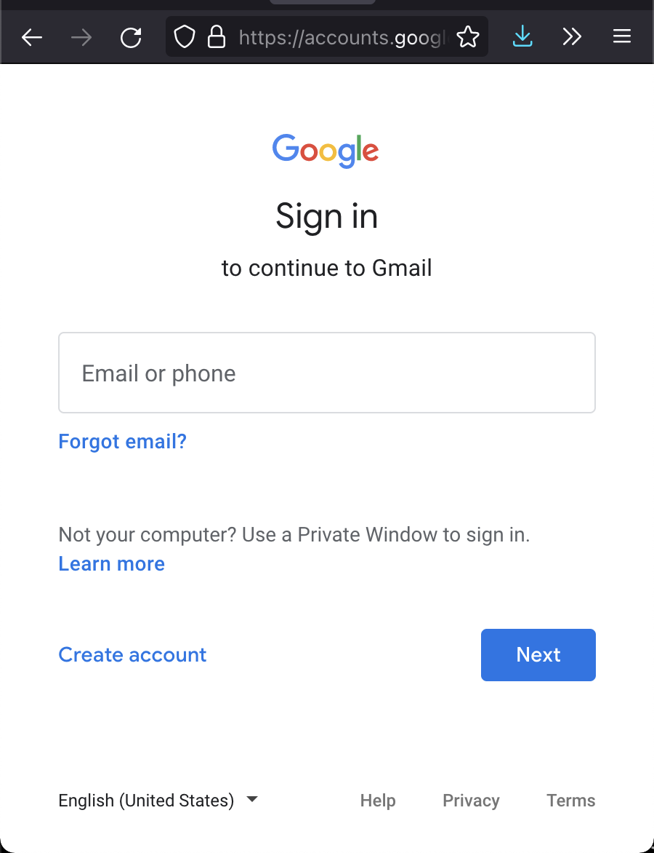
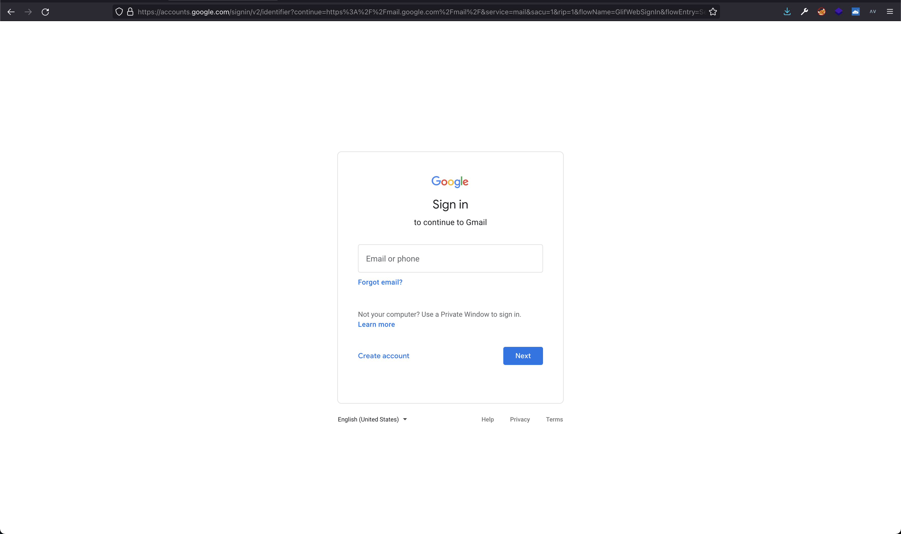
1. Achico Ventana
Problema
Hominoid: An anti-phishing plugin proof of concept – Diego Freijo
Notes:
Muchos tamaños
Margenes

Slide 19
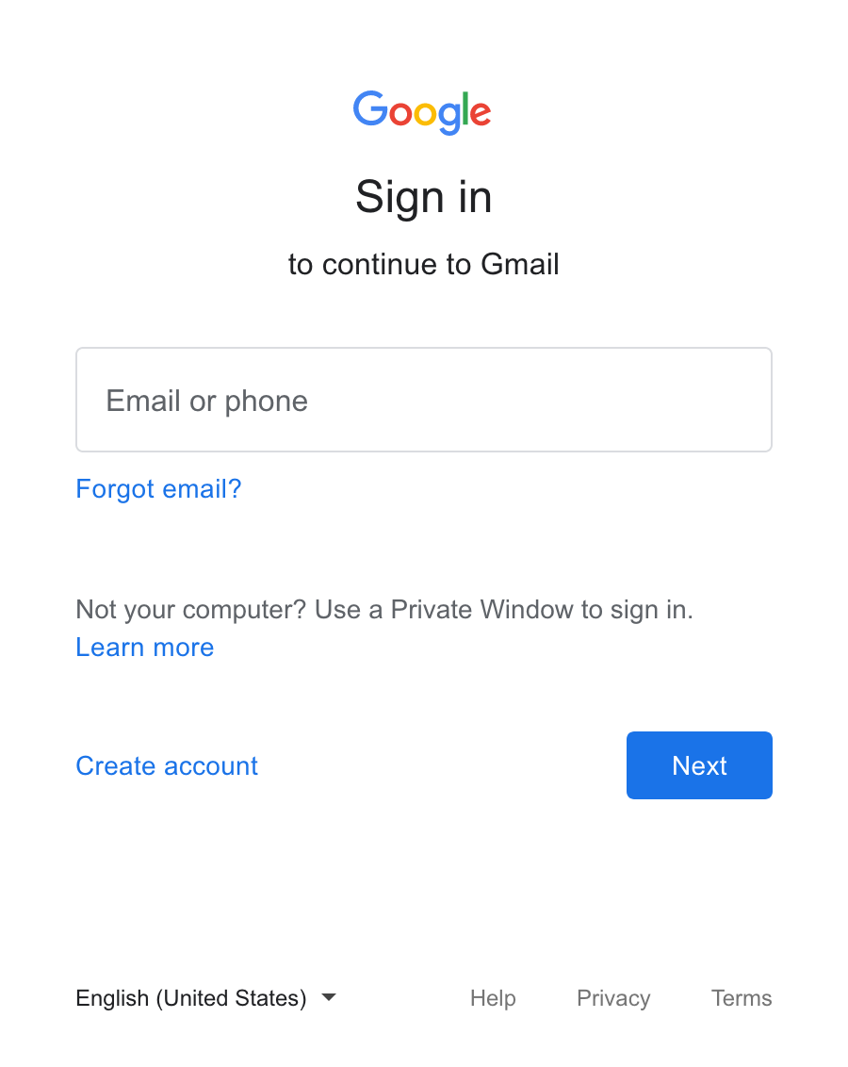
1. Achico Ventana
Solución
Achico el navegador a 360x640
Hominoid: An anti-phishing plugin proof of concept – Diego Freijo

Slide 20
2. Capturo pantalla
Uso la API browser
Recibo un string en base64
Hominoid: An anti-phishing plugin proof of concept – Diego Freijo

Slide 21
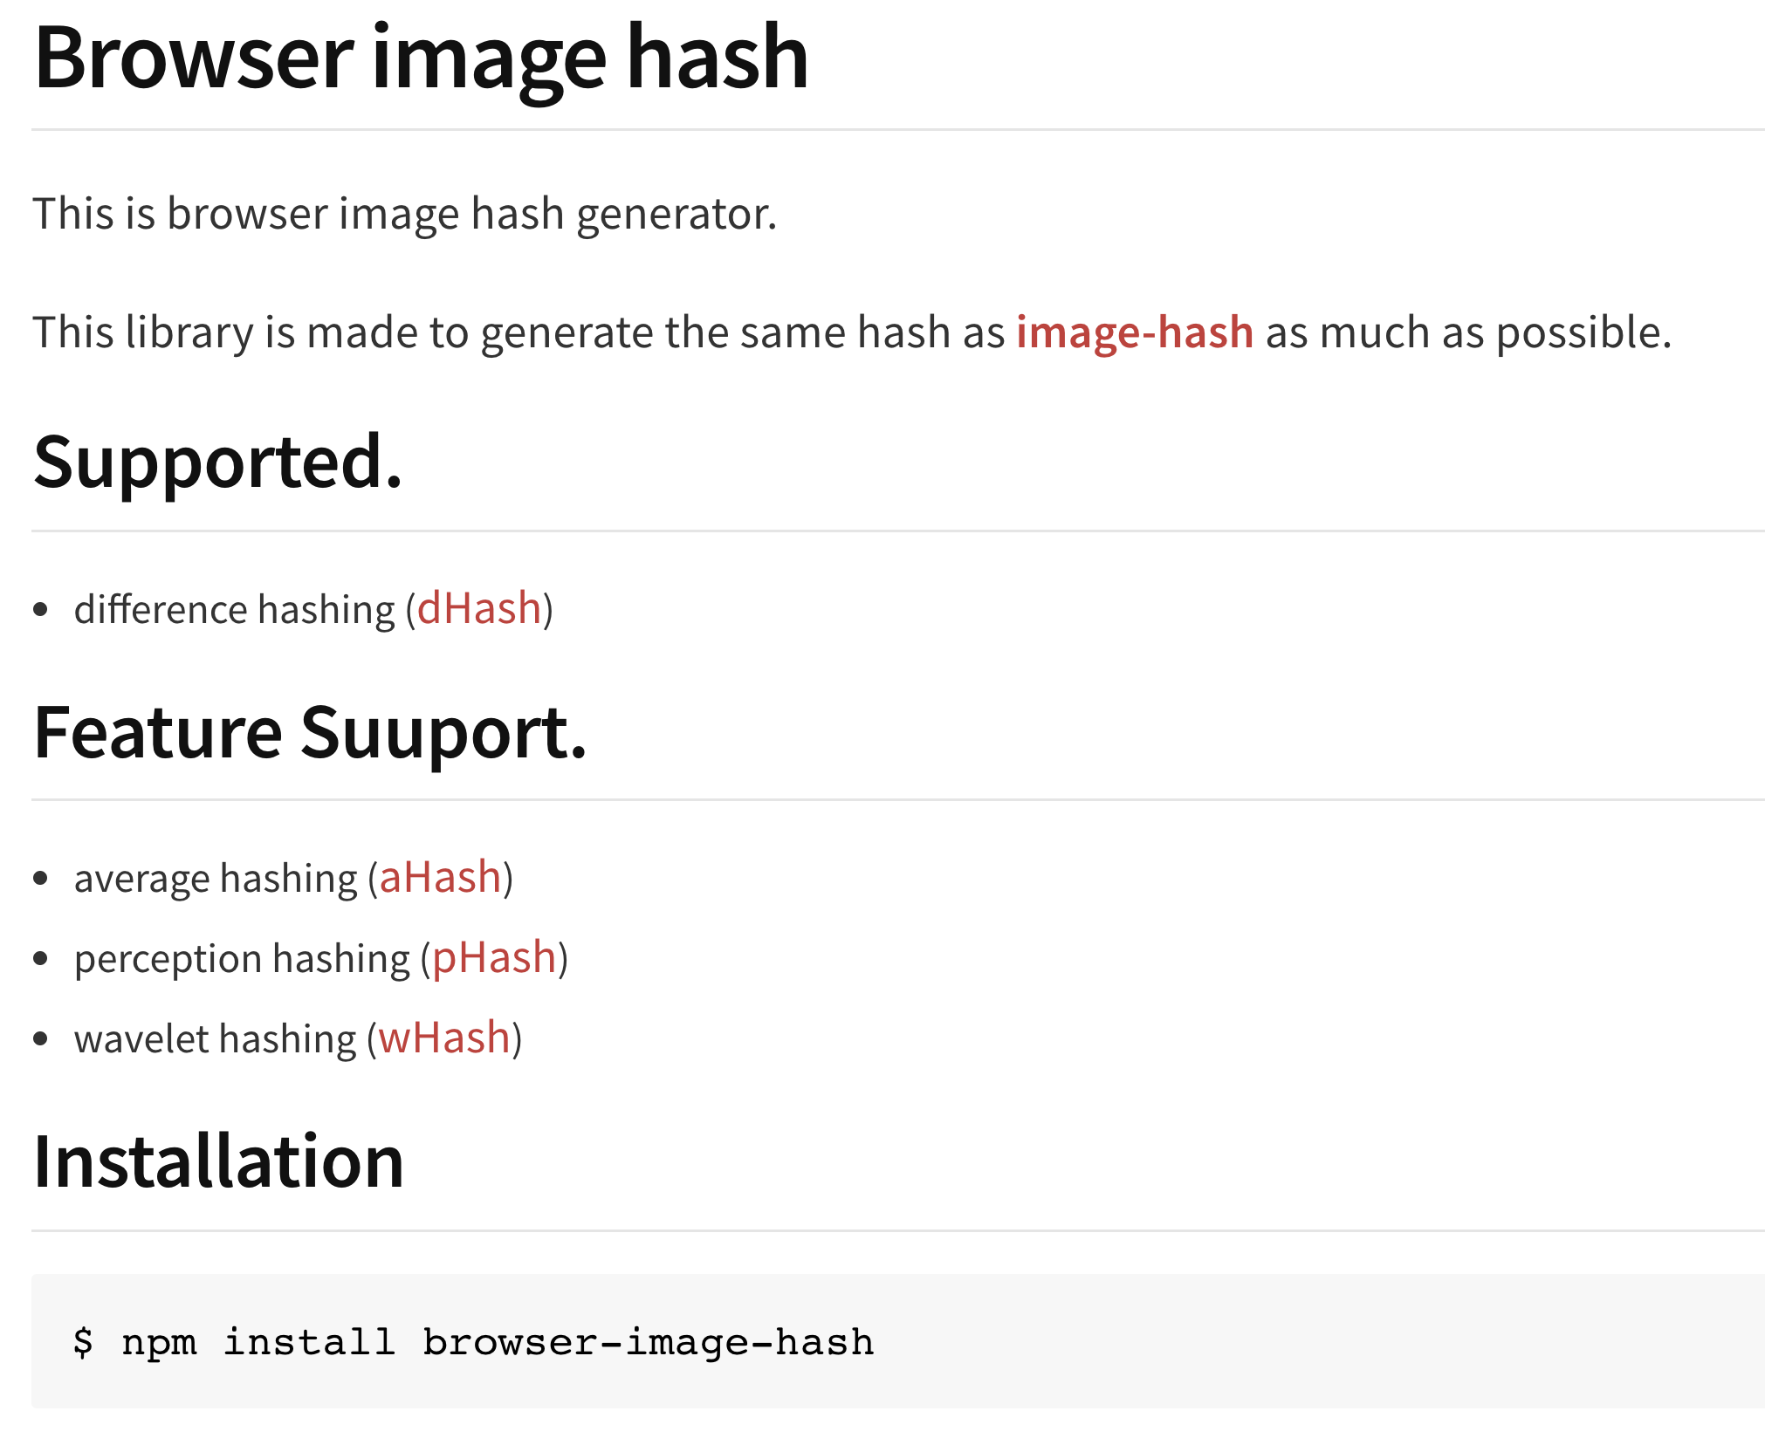
3. Calculo la firma
browser-image-hash
https://www.npmjs.com/package/browser-image-hash
Hominoid: An anti-phishing plugin proof of concept – Diego Freijo

Slide 22
3. Calculo la firma
Ejemplo de firma:
  1100111111001111000101110111100101100111011010010111100100110110
Hominoid: An anti-phishing plugin proof of concept – Diego Freijo

Slide 23
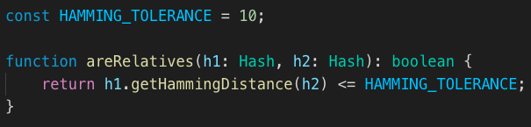
4. Verifico firma
Hominoid: An anti-phishing plugin proof of concept – Diego Freijo

Slide 24
5. Notifico al usuario
Hominoid: An anti-phishing plugin proof of concept – Diego Freijo

Slide 25
En cada pagina
1. Achico ventana
2. Capturo pantalla
3. Calculo firma
4. Verifico firma
5. Notifico al usuario
Hominoid: An anti-phishing plugin proof of concept – Diego Freijo

Slide 26
Conclusiones
Detecta ataques aún en sitios parecidos
100% privado
Funciona en sitios sin acceso público
Eficiente para usar en teléfonos
Hominoid: An anti-phishing plugin proof of concept – Diego Freijo

Slide 27
Trabajo Futuro
Mejorar el problema de achicar la ventana
Correr solo en formularios con contraseñas
Mejorar notificaciones y reporte
Probar otros HAMMING_TOLERANCE
Problema: bases de datos manchadas?
Hominoid: An anti-phishing plugin proof of concept – Diego Freijo

Slide 28
Recursos
Repo: https://github.com/anvilsecure/hominoid
Articulo con detalles:
https://www.anvilsecure.com/blog/silly-proof-of-concept-anti-phishing-using-perceptual-hashing-algorithms.html
Discusión en Reddit: https://www.reddit.com/r/netsec/comments/skdu8o/silly_proof_of_concept_antiphishing_using/
Hominoid: An anti-phishing plugin proof of concept – Diego Freijo

Slide 29




¿Preguntas?
@diegofreijo
diegofreijo.com
/in/diegofreijo
me@diegofreijo.com
Hominoid: An anti-phishing plugin proof of concept – Diego Freijo

